Slide 1


.NET São Paulo: an overview

Slide 2
.NET São Paulo: an overview
Created in December 2016
+39,000 members
Online and in-person events
.NET, Azure, Data, AI, DevOps, Infra, Software Architecture, Solutions Architecture
https://www.meetup.com/dotnet-Sao-Paulo/

Slide 3
.NET São Paulo: an overview
+150 events in 2023
+30 events em 2024
Audience from Brazil, USA, Portugal, Angola, Japan, Canada, Australia, Netherlands, Uruguay, UK...
https://www.meetup.com/dotnet-Sao-Paulo/

Slide 4
.NET São Paulo: impacts of actions
Networking
Hundreds of people certified in Azure
Thousands of professionals influenced every year
Hundreds of students impacted
https://www.meetup.com/dotnet-Sao-Paulo/

Slide 5
.NET São Paulo: impacts of actions
Hundreds of people certified in Azure
Thousands of professionals influenced every year
Hundreds of students impacted
https://www.meetup.com/dotnet-Sao-Paulo/

Slide 6
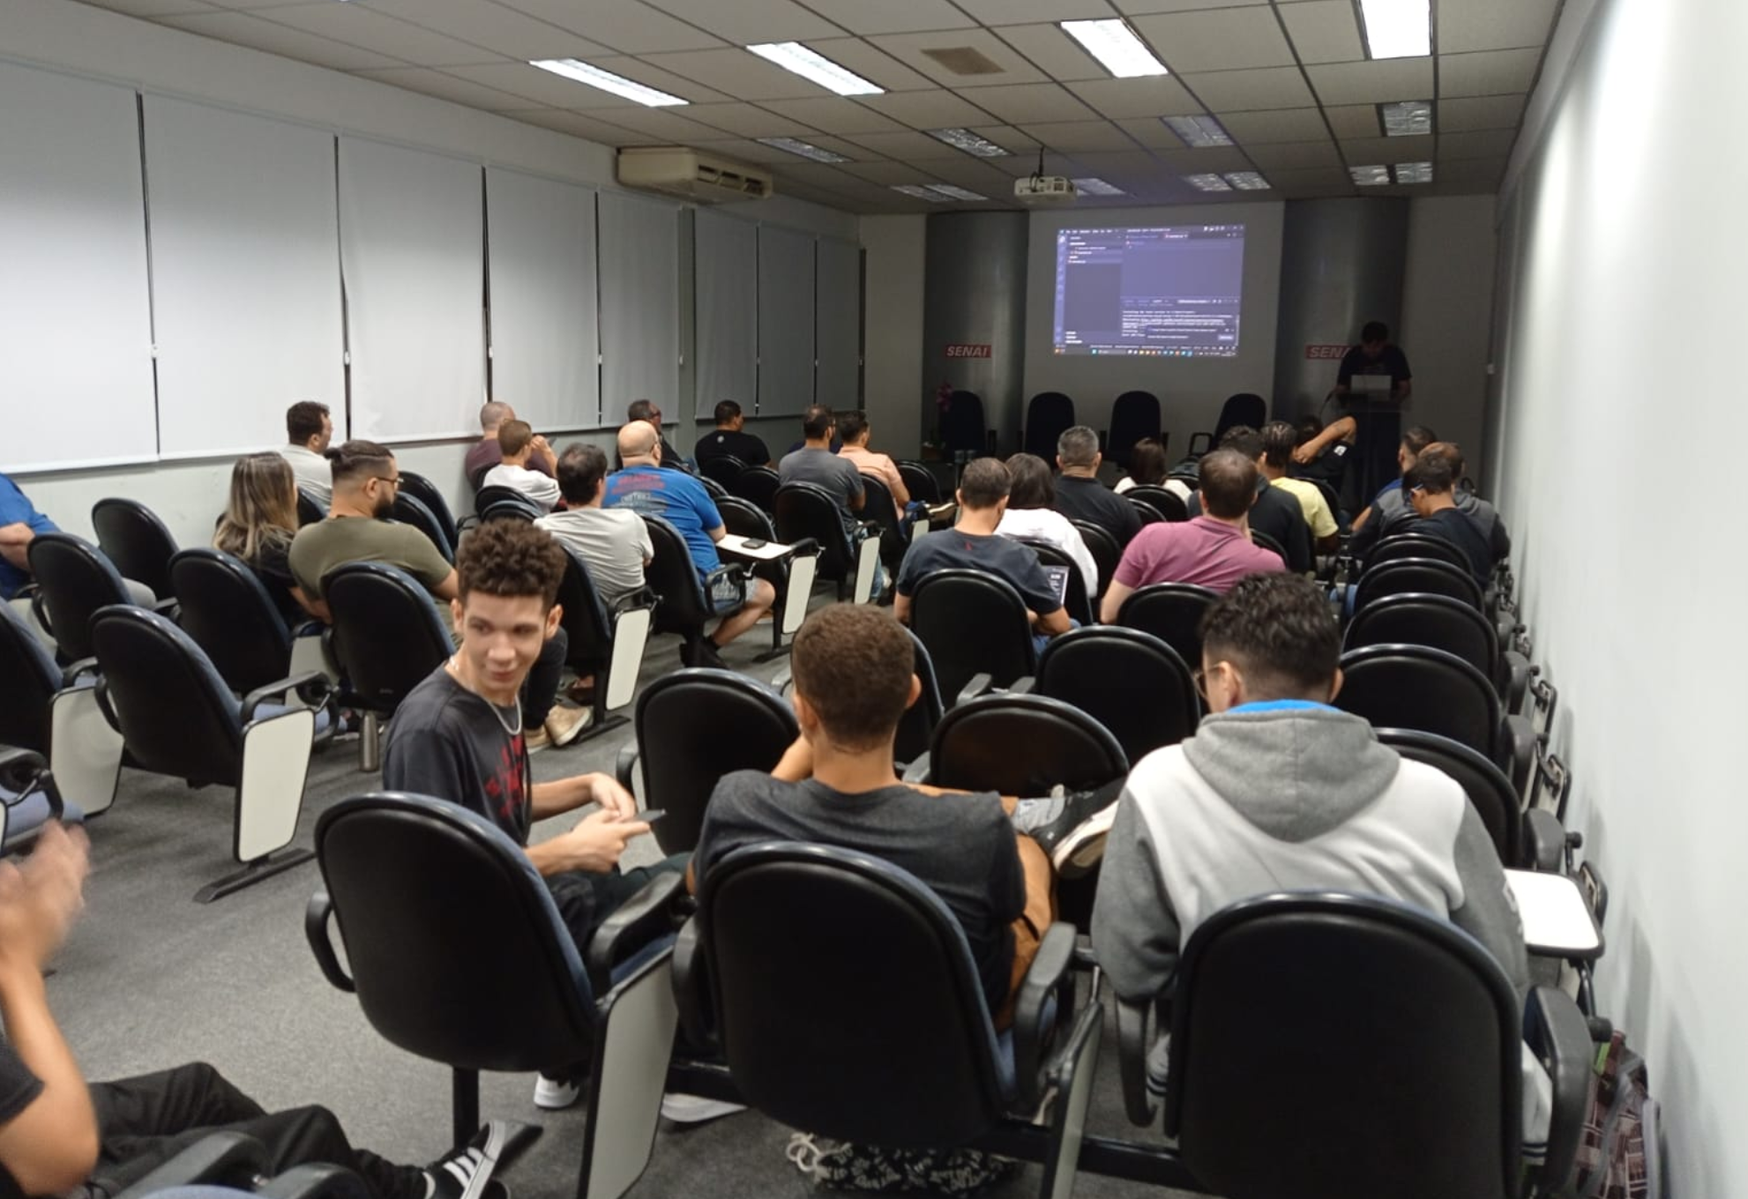
Meetup about Open AI – April, 2023
https://www.meetup.com/dotnet-Sao-Paulo/

Slide 7
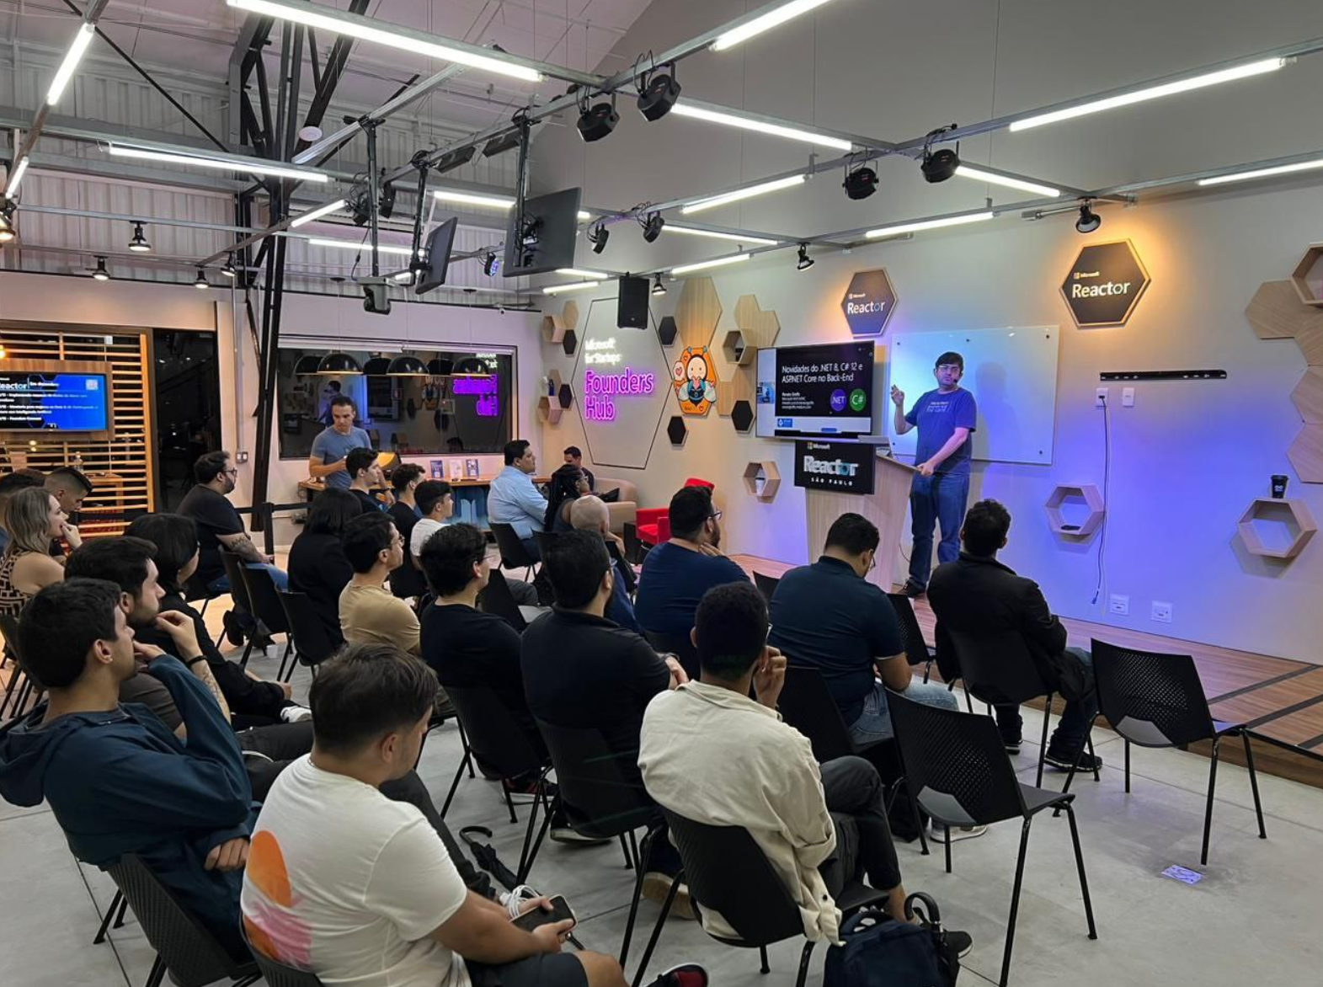
.NET Conf – January, 2024
https://www.meetup.com/dotnet-Sao-Paulo/

Slide 8
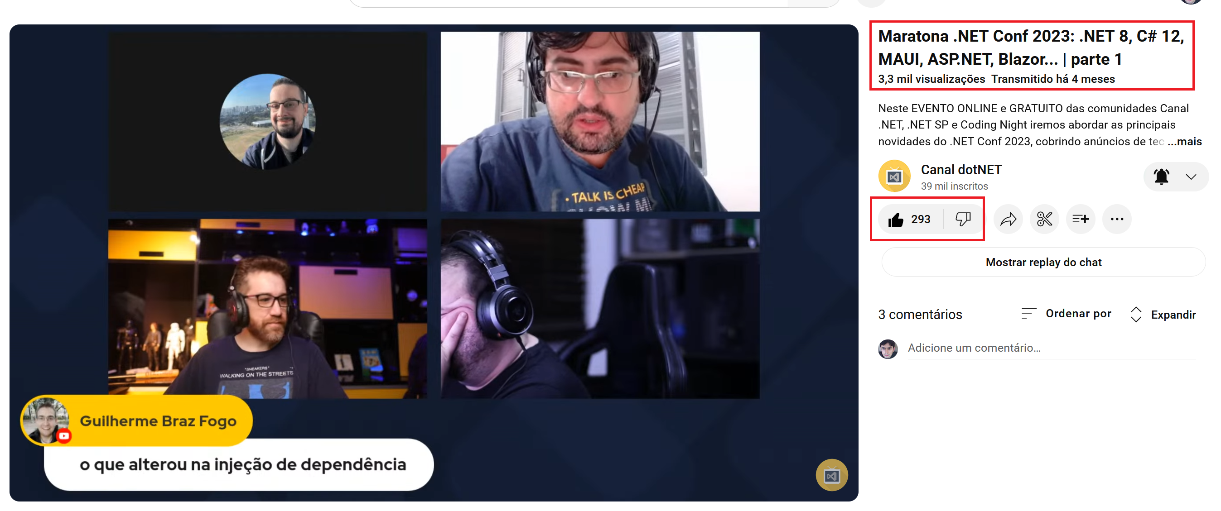
.NET Conf Online Marathon – November, 2023
https://www.meetup.com/dotnet-Sao-Paulo/

Slide 9








Partner communities
https://www.meetup.com/dotnet-Sao-Paulo/

Slide 10
Thank you!

